Slide 1
SINDy Autoencoder
Amrit Kashyap

Slide 2
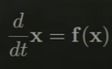
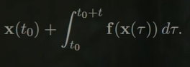
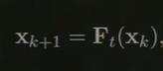
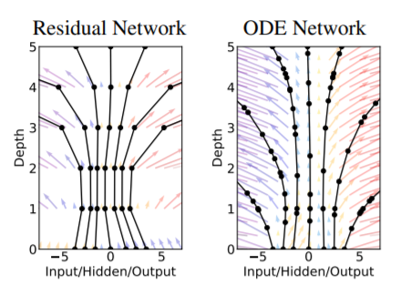
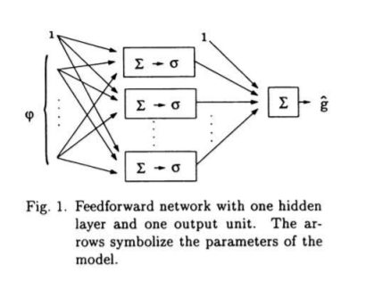
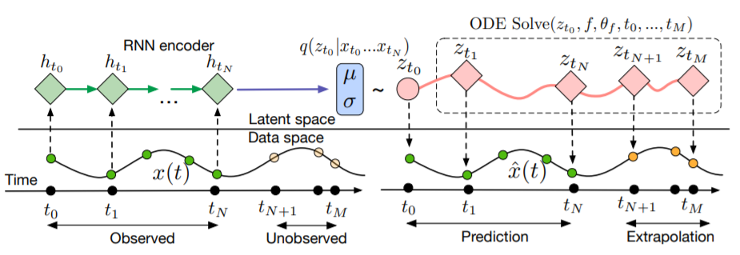
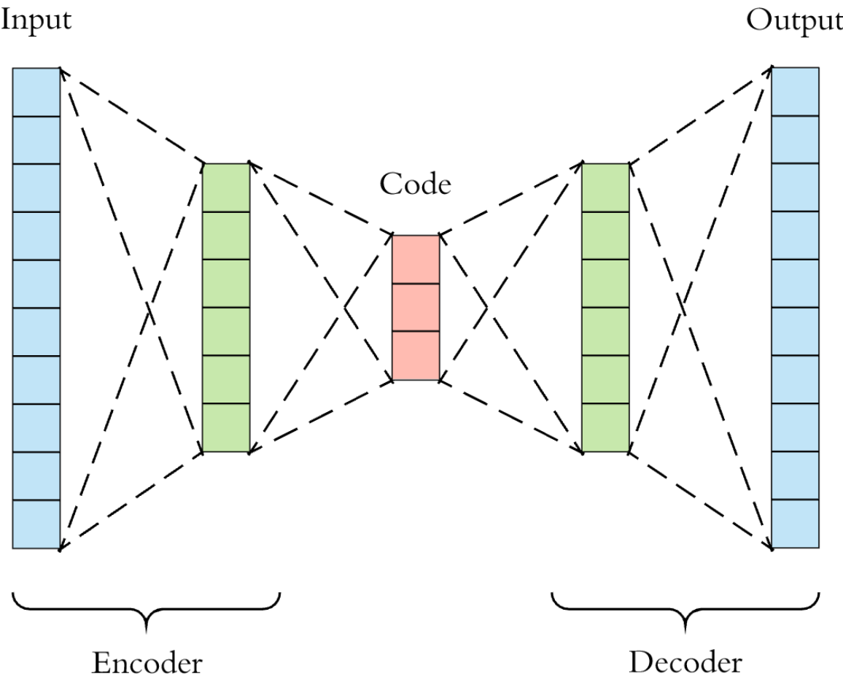
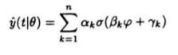
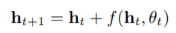
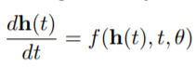
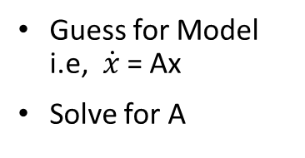
Recap find F:
Feed Forward
Autoencoder
Sjoberg 1994
Reconstructs the input via a low dimensional subspace
Examines Dynamics in a low dimensional subspace
Koopman Operators
Guess for Model i.e, $\dot{x}$ = Ax
Solve for A
Approximates F, as a RNN
Regular RNN for discrete
Neural ODE for continuous
Chen 2019

Slide 3
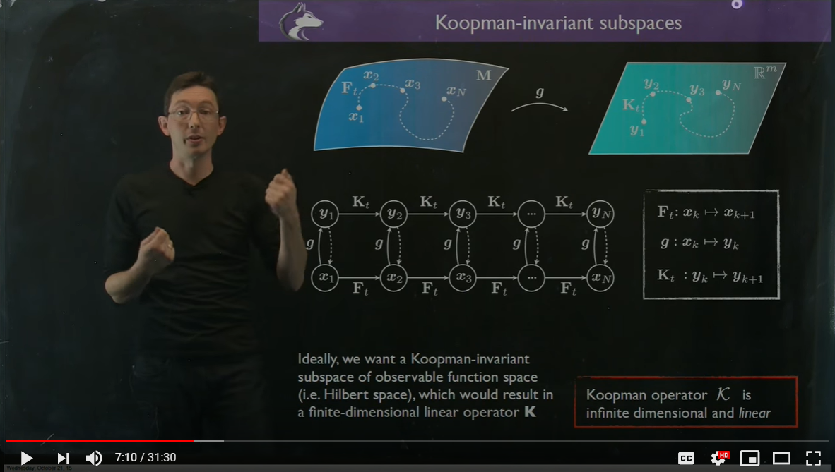
Brunton 2016

Slide 4
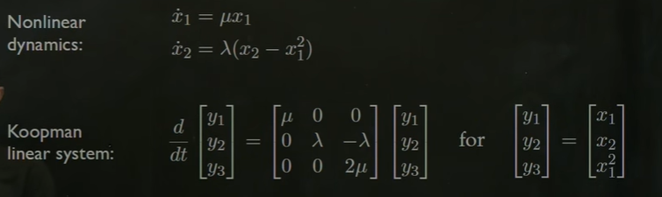
Koopman Example
Brunton 2016

Slide 5
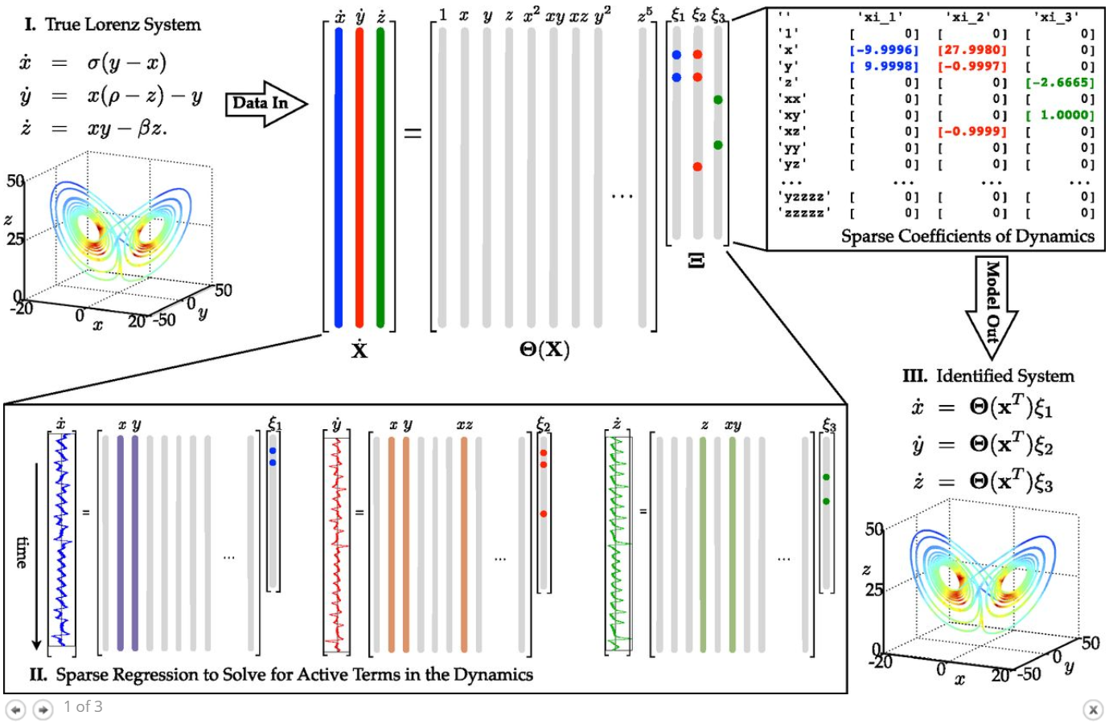
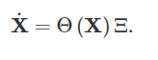
Traditional SINDY (use sparsity to solve)
Use Sparsity on coefficients to solve
Estimates the Koopman space (ideally library would be infinite to be Koopman)
Brunton 2016

Slide 6
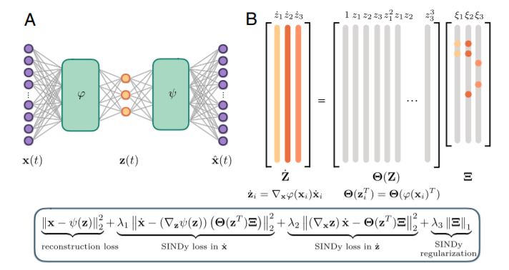
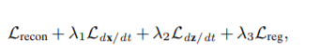
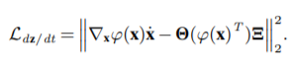
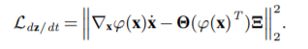
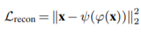
SINDy Autoencoder
Use Sparsity on coefficients to solve
Estimates the Koopman space (ideally library would be infinite to be Koopman)
Champion 2019

Slide 7
How do we Apply these tools in Neuroscience?

Slide 8
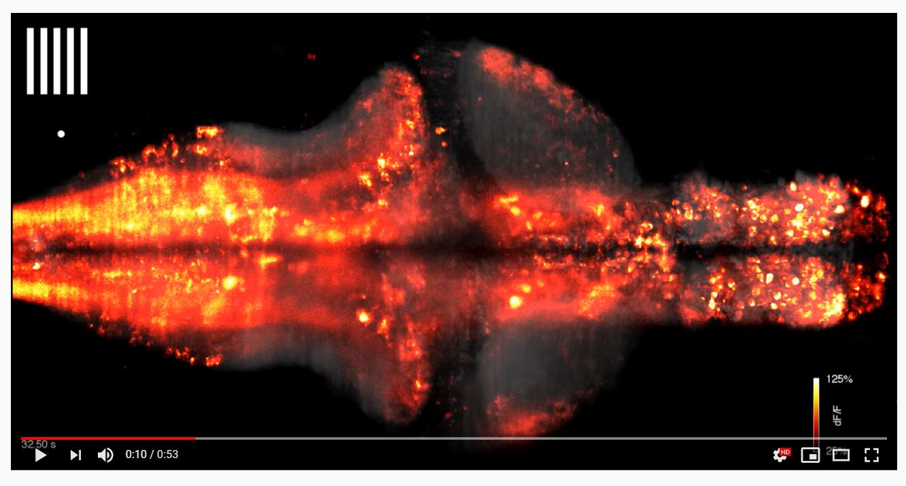
What is Whole Brain Activity?
The collective activity of the entire central nervous system
Thought to be composed of modular components in the nervous system interacting with each other and modulated by external stimuli
hard to study, need 2 measurables:
structural circuit at the macroscale level
the activity from each region
https://www.youtube.com/watch?v=YLVdRPVj-XM

Slide 9
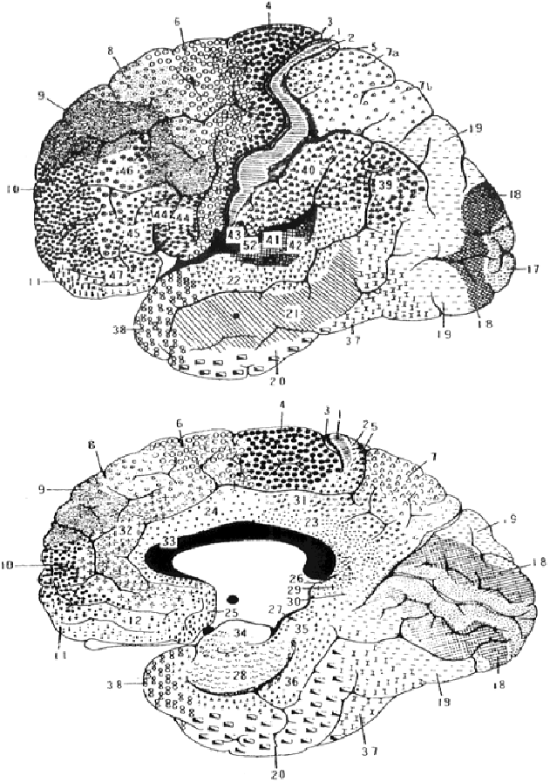
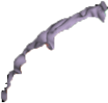
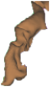
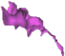
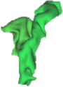
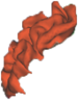


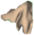
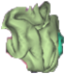
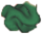



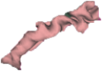

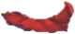
How do we turn Cortex into a discrete circuit?
Cortex is made up of Regions of Interests (Nodes) (ROI) and Connections between them
These ROI represent an assumed ‘modularization’ of brain activity and specialize in a function
Helps reduce the complexity of the problem
Not all whole brain models are discrete, continuous representation of cortical models exist (i.e Neural Field Models)
ROI Measurable Properties:
Volume
Mean Firing Rate
Network Neighbors
Broadman 1909

Slide 10
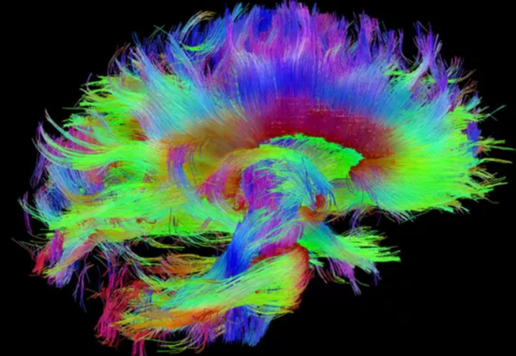
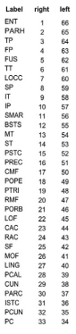
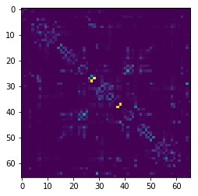
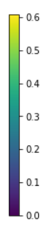
How are Macro-Scale Networks Connected?
Tractography
ROI
Most regions are connected with myelinated axons
Using Diffusion Weighted Imaging we can measure water diffusion across myelinated axons and constructs Fiber Tracts
The Structural Connectome is a matrix of the number of fibers between the different ROIs (weighted graph)
Structural Connectivity
# ROI
right hemisphere
left hemisphere
# Fiber Between ROI
Honey 2008, Kashyap 2019

Slide 11
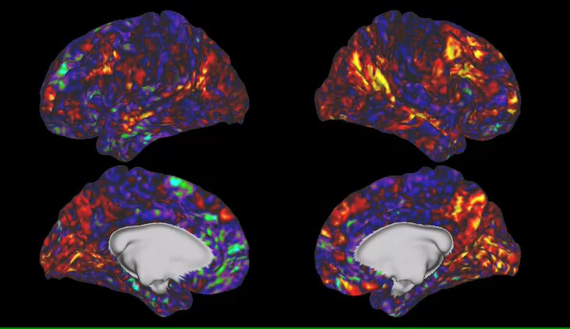
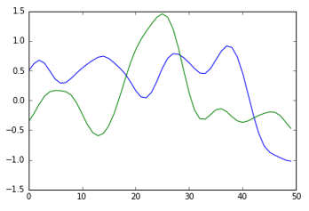
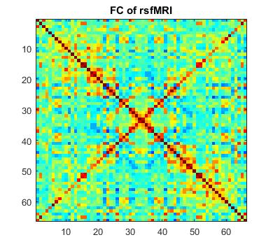
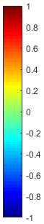
How do Brain Networks Activate over time?
Through non invasive functional Magnetic Resonance Imaging, we can estimate the activity of these regions over time in Humans (Biswal 95)
Functional Connectivity represents how correlated two ROIs are over time
fMRI is not a direct measure of Neural Activity but can be thought of a surrogate signal
Functional Connectivity
1
Amplitude
Correlation
-1
Time (sec)
# ROI
Kashyap 2019

Slide 12
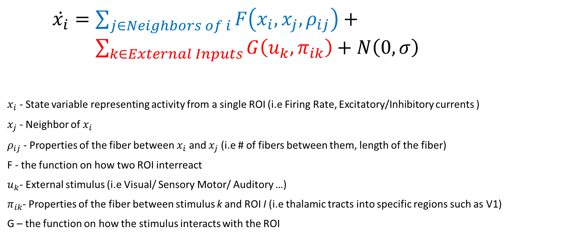
Brain Network Models
Brain Network Models (BNM) express the change in activity of one ROI with respect to the network
$\dot{x_{i}}=\sum_{j∈Neighbors of i}{F\left(x_{i}, x_{j}, ρ_{ij}\right)}+ \sum_{k∈External Inputs}{G\left(u_{k},π_{ik}\right)}+N\left(0,σ\right)$
$x_{i}$ - State variable representing activity from a single ROI (i.e Firing Rate, Excitatory/Inhibitory currents )
$x_{j}$ - Neighbor of $x_{i}$
$ρ_{ij}$ - Properties of the fiber between $x_{i}$ and $x_{j}$ (i.e # of fibers between them, length of the fiber)
F - the function on how two ROI interreact
$u_{k}$- External stimulus (i.e Visual/ Sensory Motor/ Auditory …)
$π_{ik}$- Properties of the fiber between stimulus k and ROI I (i.e thalamic tracts into specific regions such as V1)
G – the function on how the stimulus interacts with the ROI
Activity due to the Network
Activity due to External Inputs

Slide 13
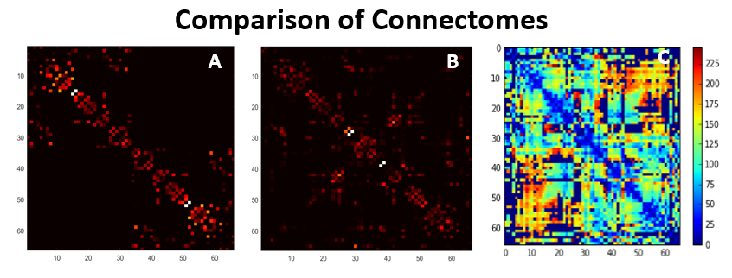
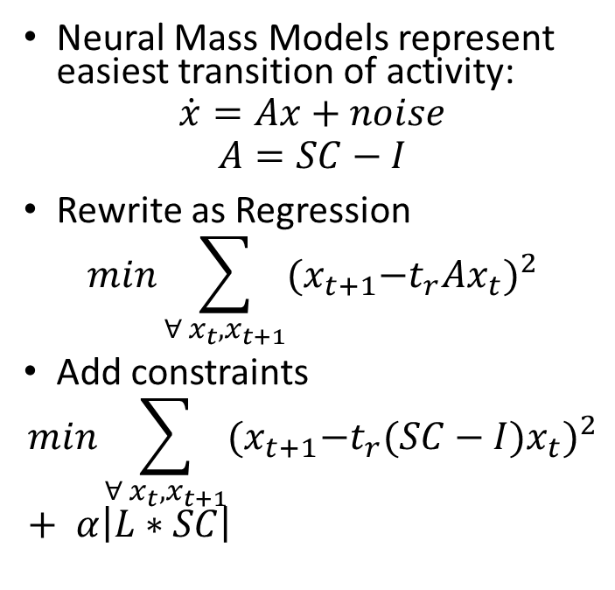
Example 1: Use Feedforward Model
Structural Constraints
Neural Mass Models represent easiest transition of activity:
$$\dot{x}=Ax+noise$$
$$A=SC−I$$
Rewrite as Regression
$$min\sum_{∀ x_{t},x_{t+1}}{{(x}_{t+1}−t_{r}Ax_{t})^{2}}$$
Add constraints
$$min\sum_{∀ x_{t},x_{t+1}}{{(x}_{t+1}−t_{r}(SC−I)x_{t})^{2}}+ α\left|L∗SC\right|$$
Lengths between ROI in mm
Kashyap 2020 prep

Slide 14
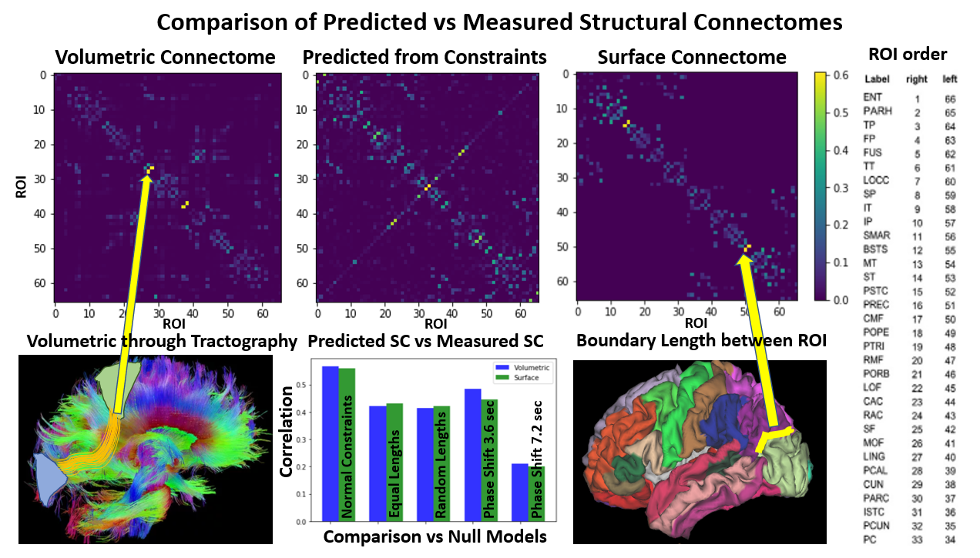
Kashyap 2020 prep

Slide 15
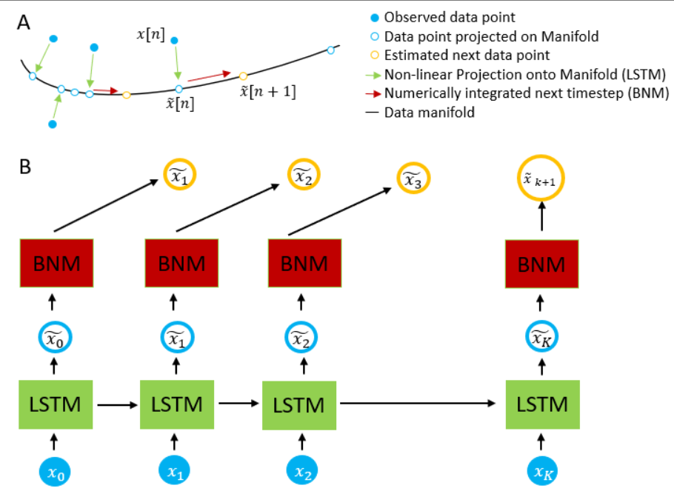
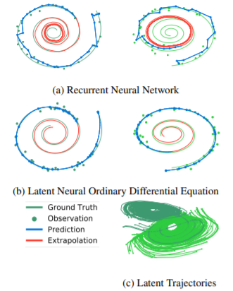
Example 2: Use Neural ODE to learn Trajectories

Slide 16
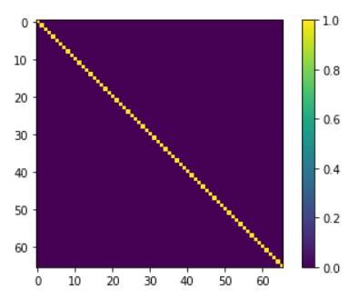
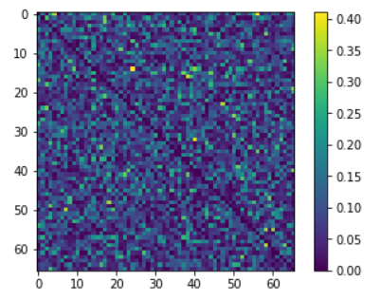
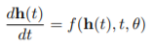
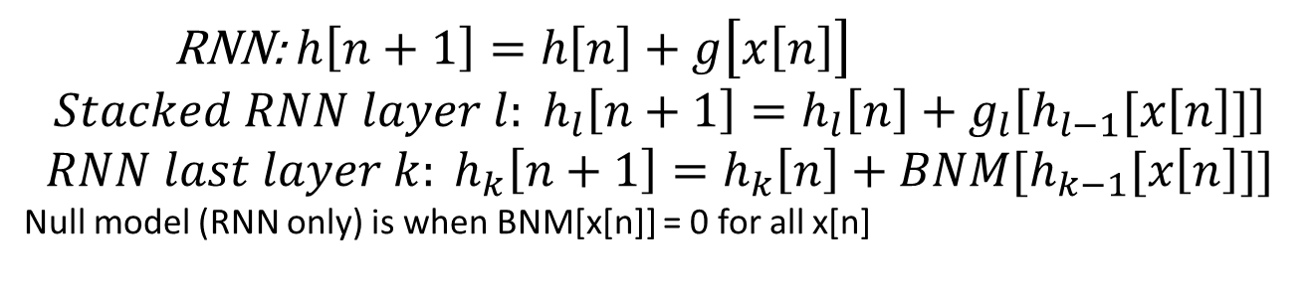
Null Models with Machine Learning
Test 3 different models (varying only structural matrix: estimate of the structural matrix through DTI, identity matrix (null model), a random matrix (counterfactual hypothesis):
Structural Network
Identity (Null Model)
Random Matrix
RNN: $h\left[n+1\right]=h\left[n\right]+g\left[x\left[n\right]\right]$
$$Stacked RNN layer l: h_{l}\left[n+1\right]=h_{l}\left[n\right]+g_{l}\left[h_{l−1}[x\left[n\right]]\right]$$
$$RNN last layer k: h_{k}\left[n+1\right]=h_{k}\left[n\right]+BNM[h_{k−1}[x\left[n\right]]]$$
Null model (RNN only) is when BNM[x[n]] = 0 for all x[n]

Slide 17


Neural ODE outperform Null Model
Predicting across unseen Datasets
Prediction at 2.16 sec
Prediction at 2.2 sec
660 trials for each test category
Kashyap 2020

Slide 18

Conclusion
Feed Forward
Feed Forward Regression estimates parameters of a given model (ex. Network structure given model on how neural populations interact as a function of structure)
Neural ODE estimates the manifold of all trajectories via piecewise integration of a model (ex. Can predict how the system should evolve)
SINDy does both, estimates the model as a function and gives a model on how the system should evolve
Neural ODE
SINDy

